Slide 1

Virtual Book Club
VBC ITI Final Project ….. VBC ITI Final Project...
VBC.

Slide 2

Student: Mennatallah Yousri
University: Arab Academy for Science, Technology and Maritime Transport
Faculty: Electronics and Communication Engineering
_________________________________________________________________________________________________________________________________________________________________________________
Lecturer: Dr. Kamal Radwan
Group: ITI Python AAST

Slide 3
Languages & Tools
HTML
CSS
Bootstrap 4
SQL
PHP
JQuery

Slide 4

About project
VBC ITI Final Project ….. VBC ITI Final Project...
This project resembles a social cataloging website that stores a collection of book details including title, author, name, ISBN 13, year of publishing, number of pages of the paperback version and book reviews. It has an affiliated stationary store managed by the admins which offers items that help enrich the reader's experience and encourage them to read more, such as book-inspired bookmarks, kindle night readers and note taking gadgets.

Slide 5
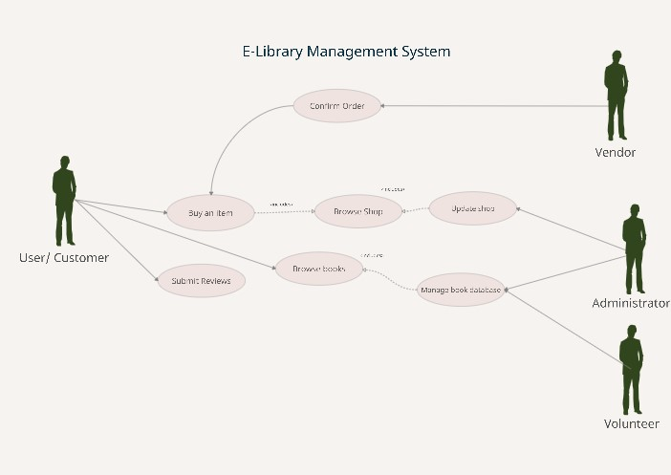
Use Case Diagram
Describes the relationship between:
Admins
Users
Volunteers
Vendor

Slide 6
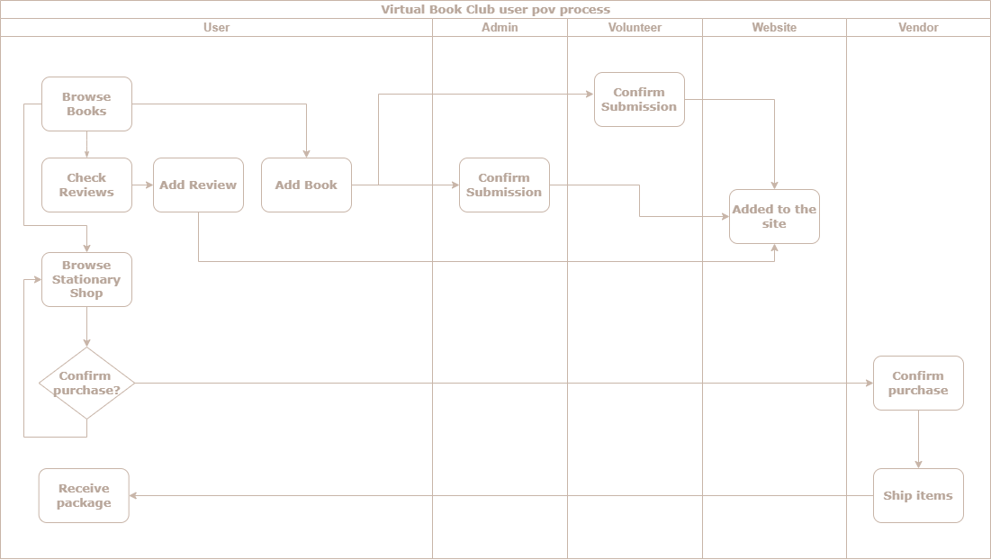

Slide 7
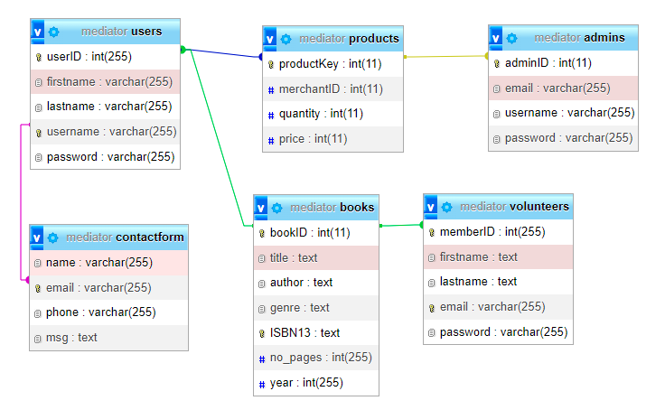
Database Schema
23/08/2022
VBC
7

Slide 8
Website Showcase
VBC ITI Final Project ….. VBC ITI Final Project…….. VBC ITI Final Project ….. VBC ITI Final Project………

Slide 9




Home

Slide 10

Browse Books
Block Quote Header
Automatic Card Carousel
Footer

Slide 11

Affiliated Shop
1.
Simple and efficient to use
2.
Modern Design
3.
Click to enlarge

Slide 12
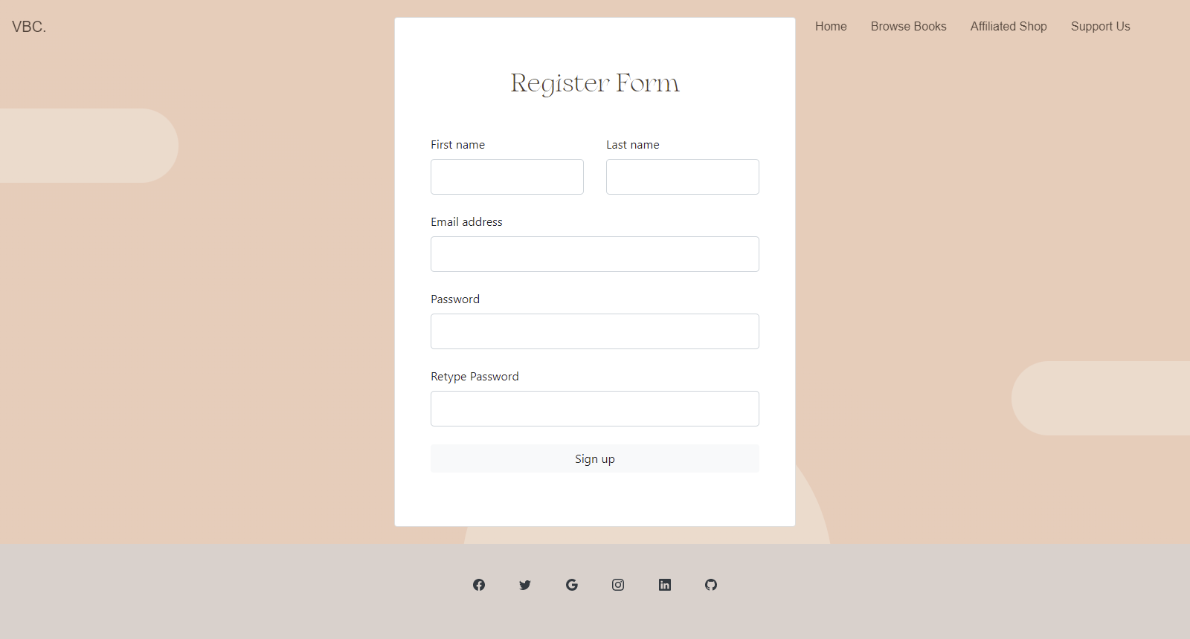
Register to be a volunteer
Help the admins with library management

Slide 13
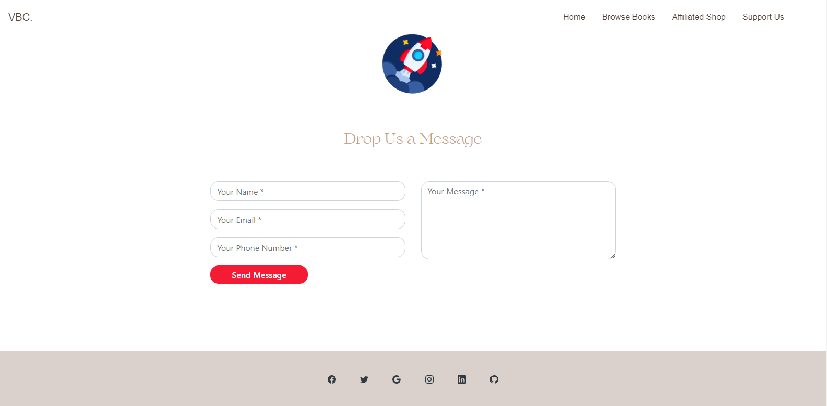
Suggest Improvements

Slide 14
Future plans
Login system
Order
Web scrape
Create a login system for user to be able to track their own collections and
Retrieve book data from the dataset to arrange books by them.
Example: Arrange by genre, author, age group, etc.
Collect information about desired by books from websites across the web to provide acute information.

Slide 15

Thank you
VBC ITI Final Project ………... VBC ITI Final Project...........
VBC.​

